Slide 1
Introduction to Deep Learning
With PyTorch

Slide 2
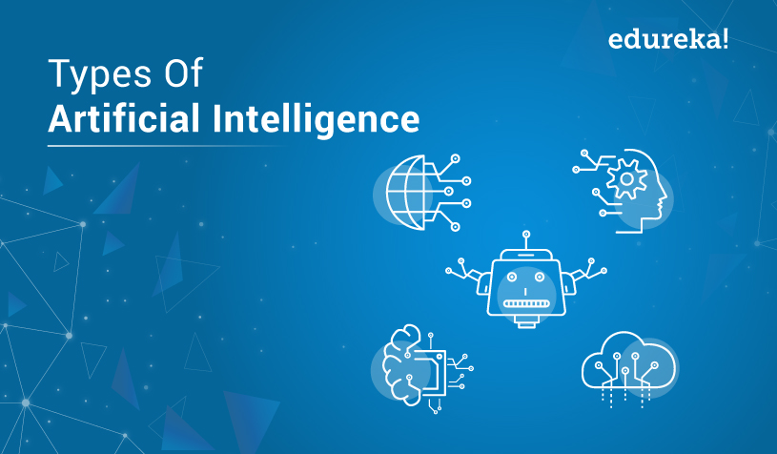
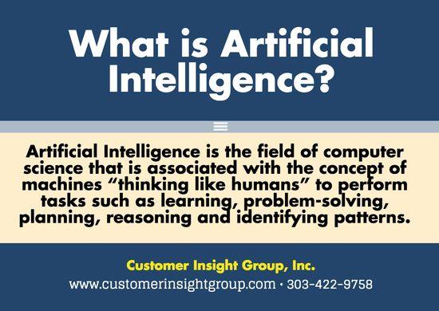
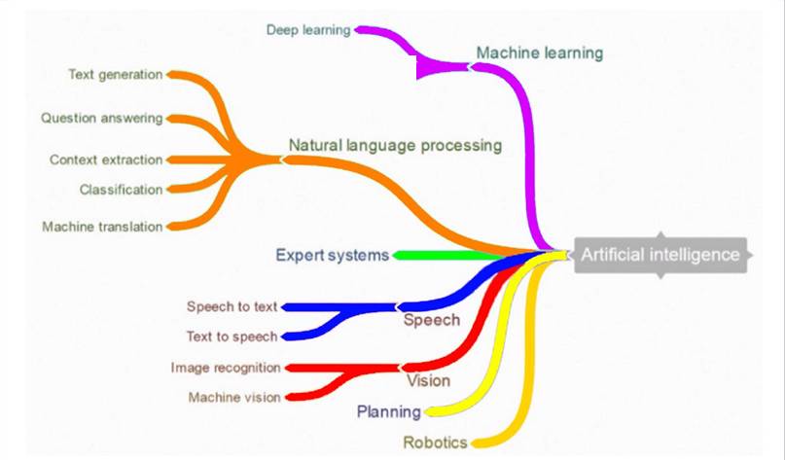
What is AI?

Slide 3
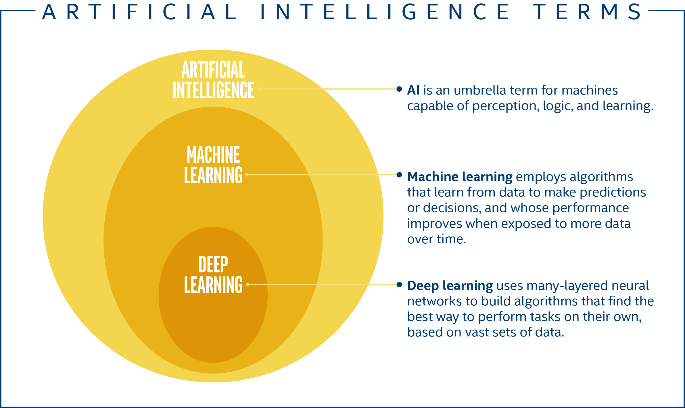
AI, ML, DL?

Slide 4
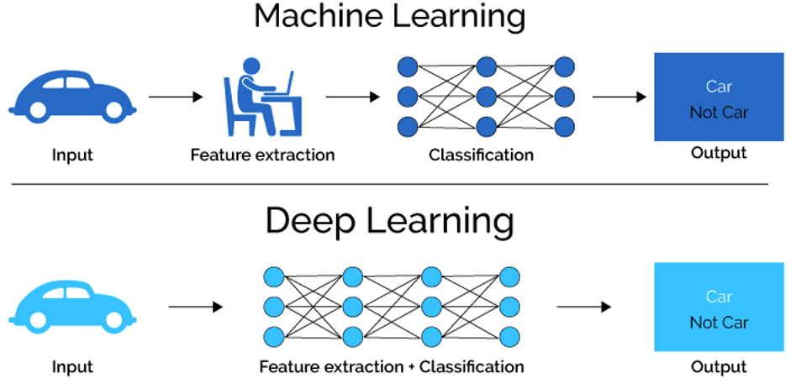
ML and DL?

Slide 5
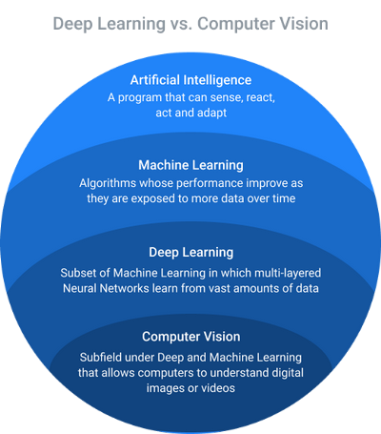
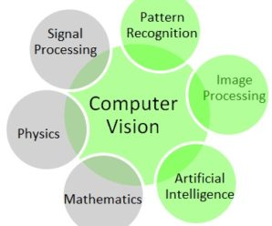
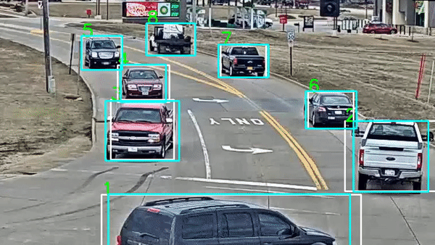
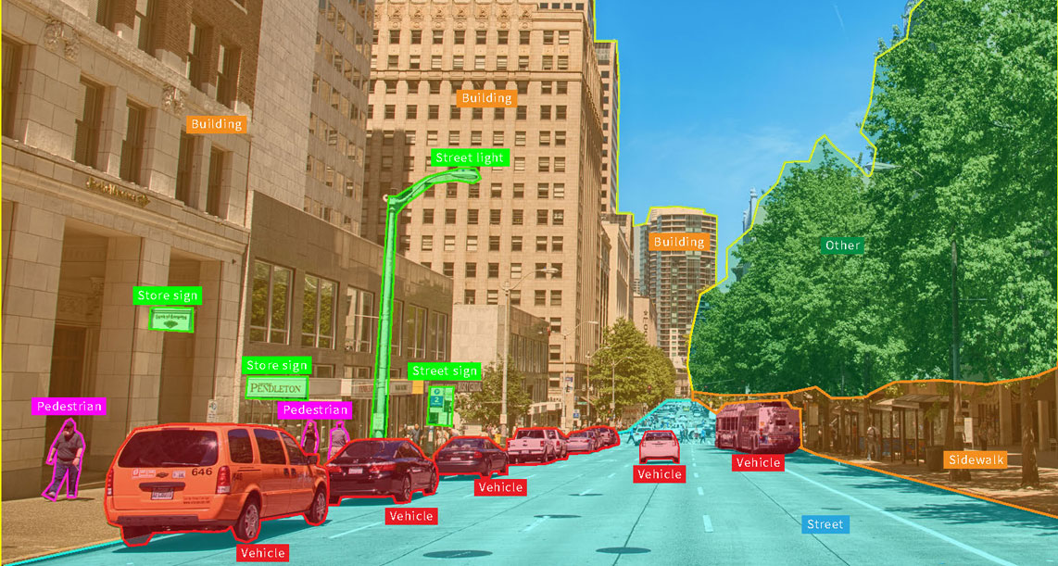
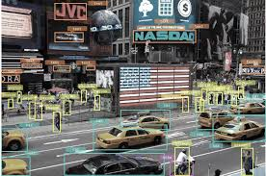
DL and CV?

Slide 6
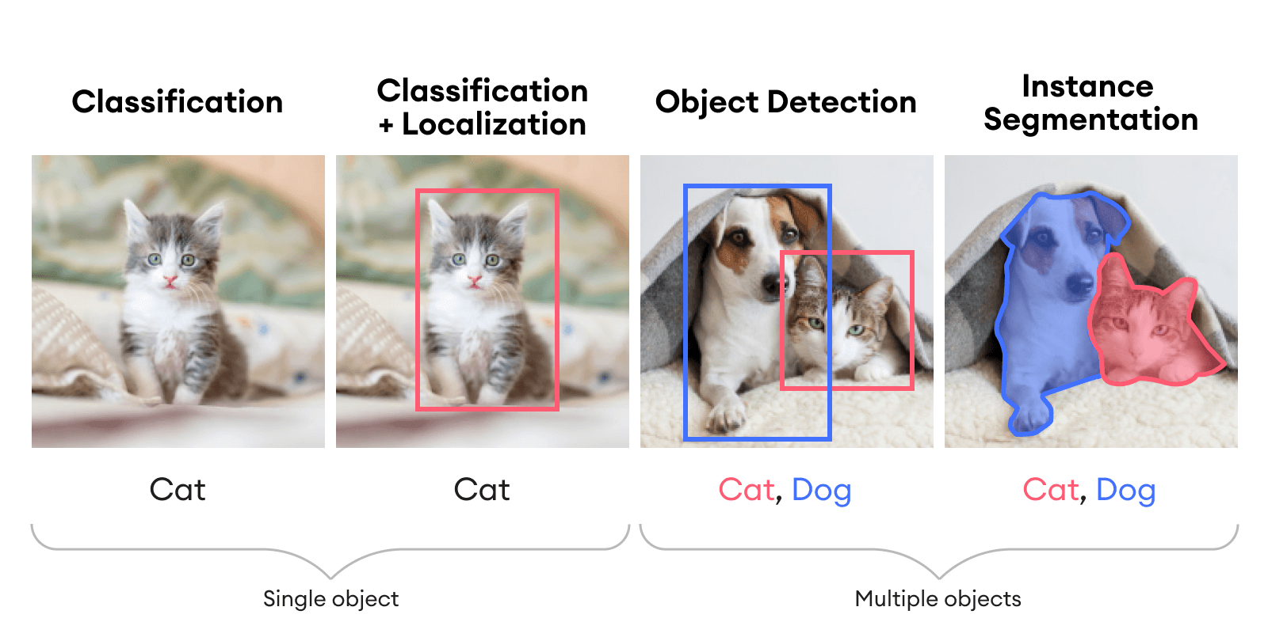
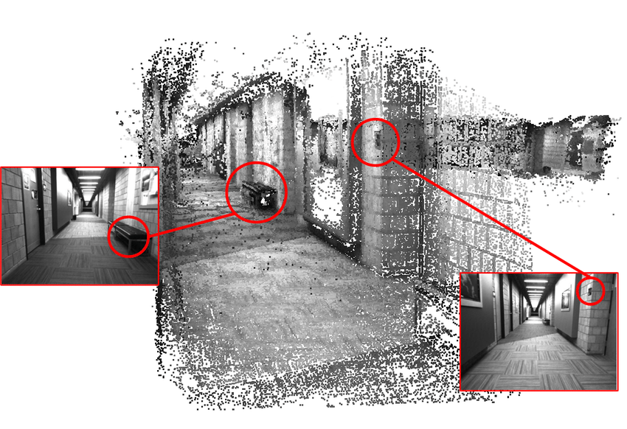
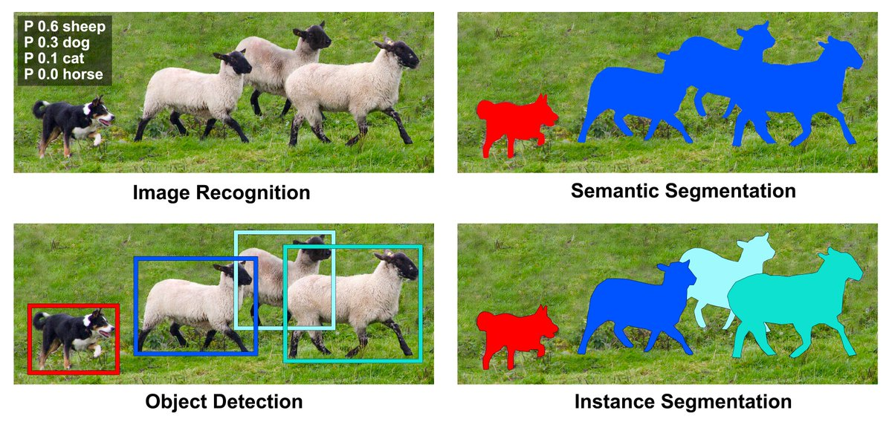
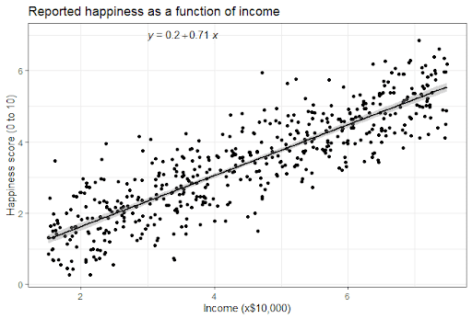
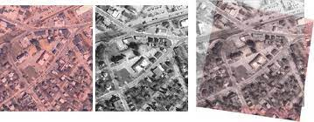
Tasks Related to DL/ CV
Classification
Regression
Detection
Tracking
Segmentation
Registration
3D Reconstruction
3D Computer Vision

Slide 7
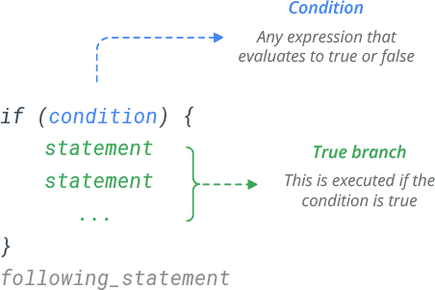
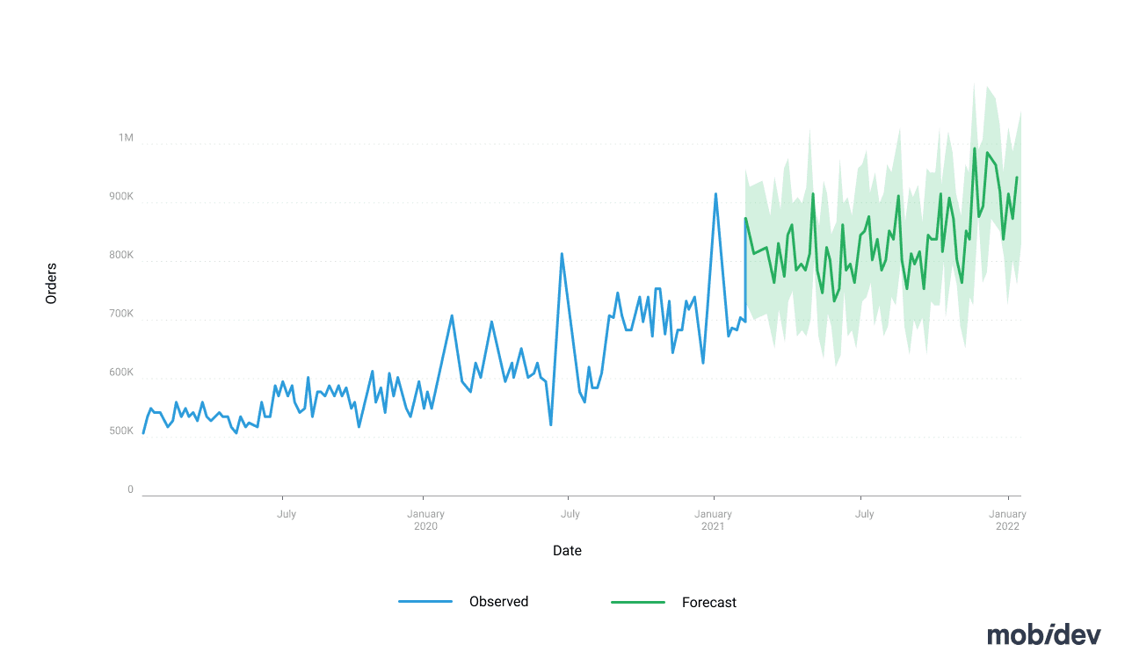
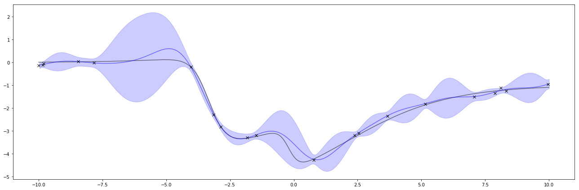
Is DL a Remedy for Everything?
Decision-making
Forecasting
Predictions/ Uncertainty Analysis

Slide 8

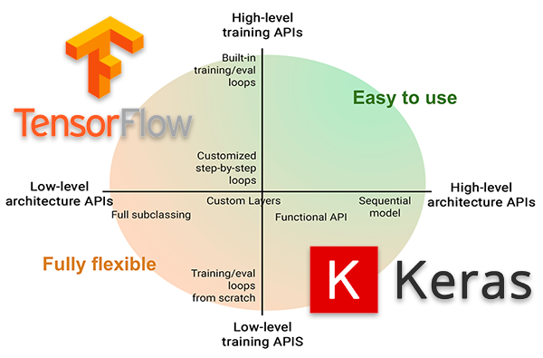

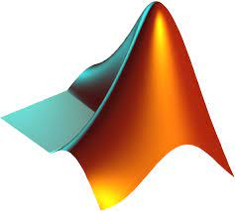
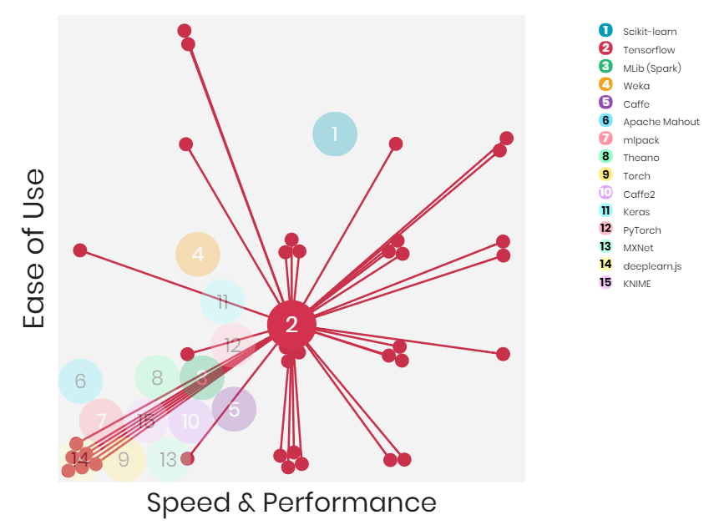

DL Frameworks

Slide 9
How To Start Solving DL Problems?
Get a Good GPU and RAM for model training (or use cloud)
Install OS, NVIDIA drivers, CUDA, cuDNN libs
Install Anaconda/ Python. Create Environment and Select DL Framework
OS: Windows/ Ubuntu (Recommended)
Setup development environment
Install libraries and their dependencies
Pay attention to versions
Understand the problem/ Prepare or download the datasets related to the task
For custom datasets, first acquire it and then annotate it
Annotation Tools: MATLAB ImageLabeler, LabelMe etc.
Model Training/ Testing
Model Evaluation

Slide 10
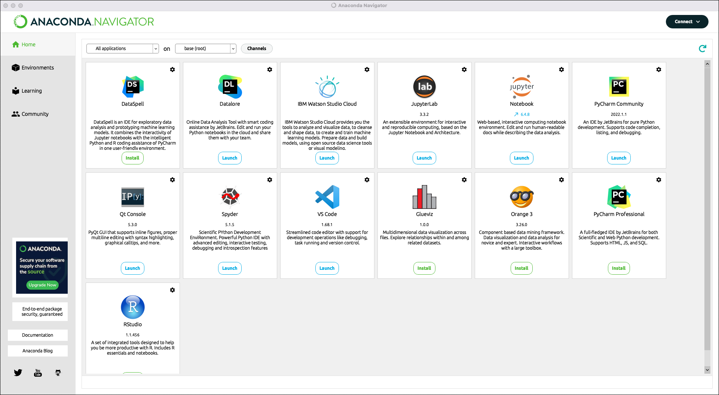
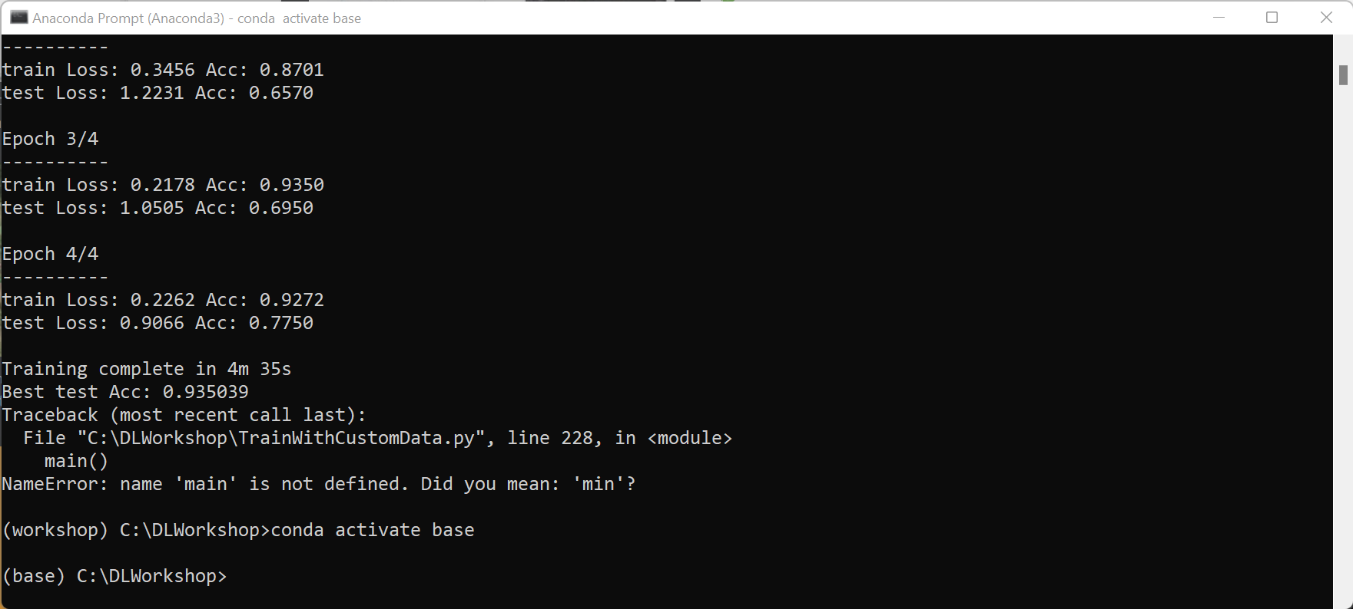
Anaconda

Slide 11
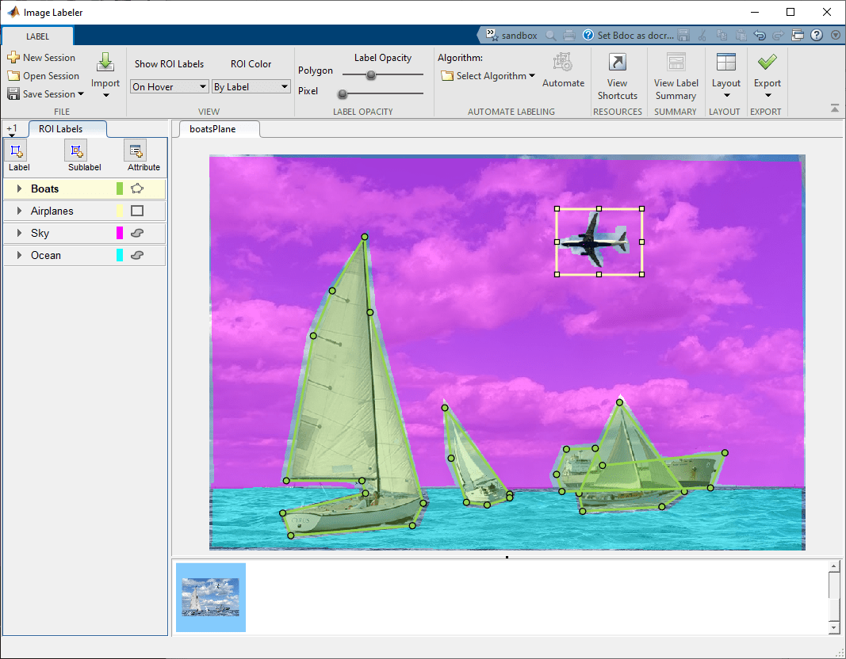
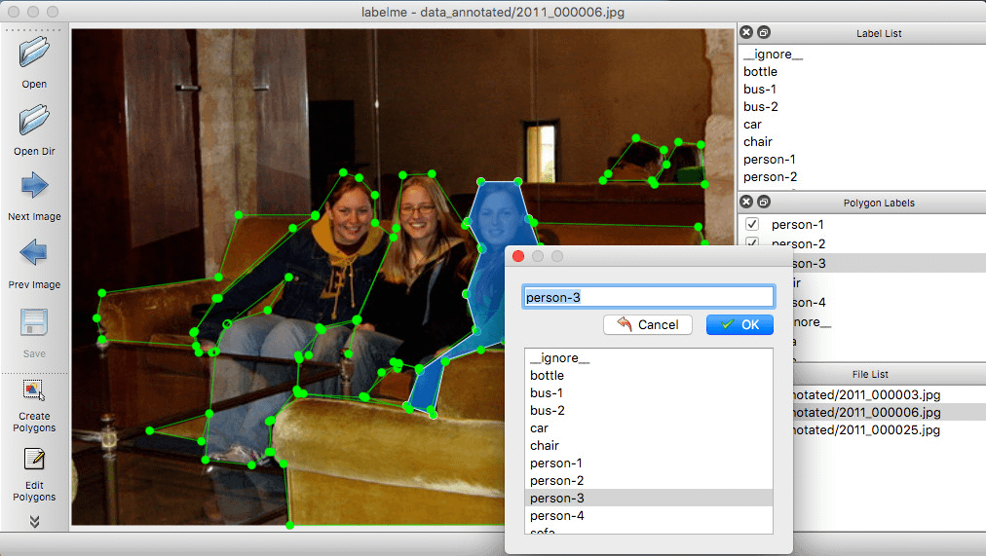
Ground Truth Annotation Tools

Slide 12
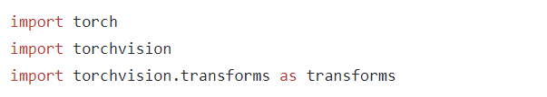
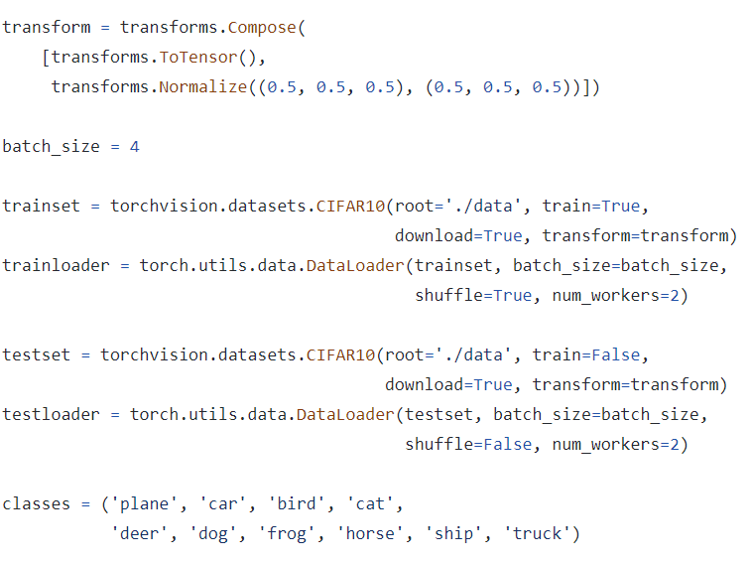
Example: A Simple Classification Network Step # 1: Load Dataset
https://github.com/taimurhassan/DLTutorials

Slide 13
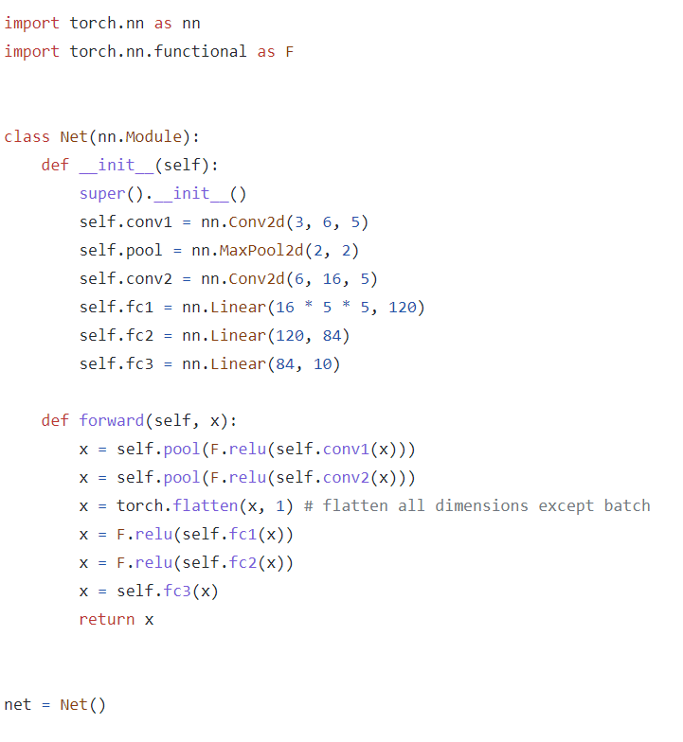
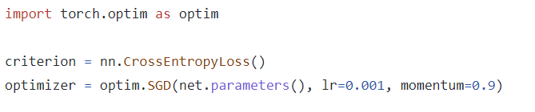
Example: A Simple Classification Network Step # 2: Create the Network and Optimizer
https://github.com/taimurhassan/DLTutorials

Slide 14
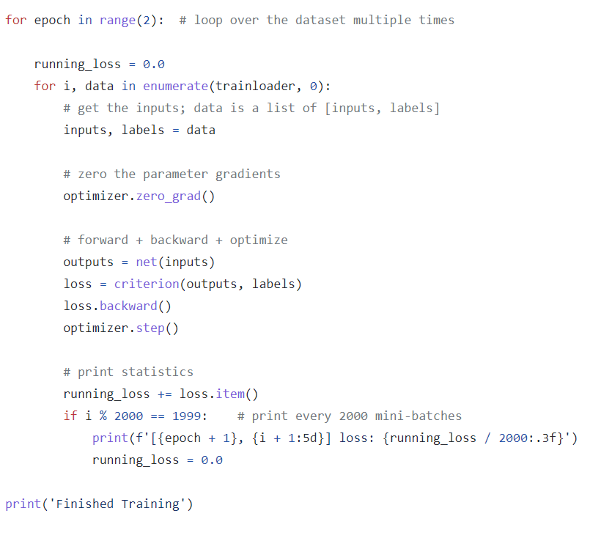
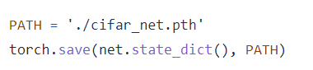
Example: A Simple Classification Network Step # 3: Write Training Routine
https://github.com/taimurhassan/DLTutorials

Slide 15
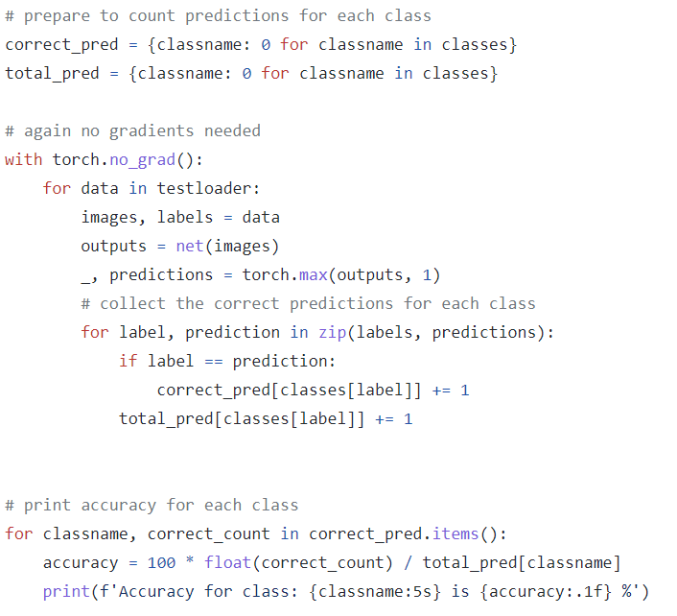
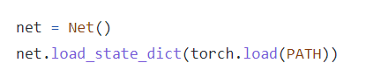
Example: A Simple Classification Network Step # 4: Test and Evaluate the Trained Model
https://github.com/taimurhassan/DLTutorials

Slide 16
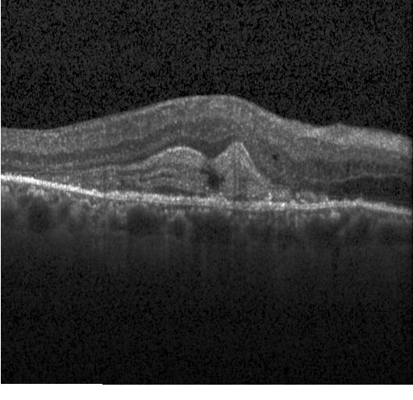
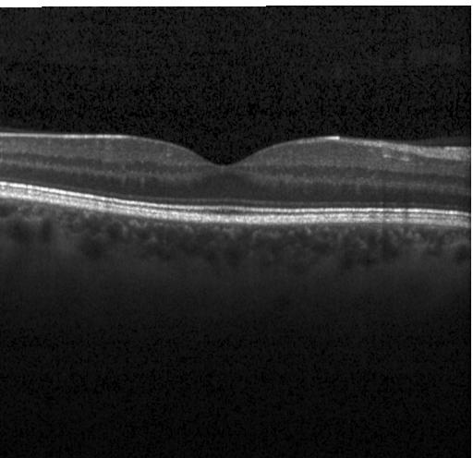
Exercise (Image Classification): Training Model on Custom Dataset
Use the given dataset to predict retinal diseases.
Link
Steps:
Install OS, Anaconda, Python
Load Anaconda and Create Environment
Install Pip, PyTorch, Torchvision, pandas, scikit-image, matplotlib and all the dependencies
Download the code file ‘TrainWithCustomData.py’ from the GitHub
Run it and compute the results (in terms of accuracy)
Understand the code and explain it in the next session
Use to same code to classify digits in MNIST dataset
https://github.com/taimurhassan/DLTutorials

